Slide 1

LEGACY LEARNERS
UNIVERSITY OF SASKATCHEWAN – COLLEGE OF ENGINEERING
Harini Krishnaraj, Sam Egunjobi, Grace Martinez, Anna Wiens, and Talia Iwanchysko

Slide 2

INTRODUCTION
PROBLEM STATEMENT
A persistent communication gap exists between experienced tradespeople and newer workers, where critical hands-on knowledge is informally shared, poorly documented, and increasingly difficult to pass on during workforce transitions.

Slide 3
SOLUTION
VALUE PROPOSITION
STAKEHOLDERS
INTEGRATION
Retains critical hands-on knowledge
Improves efficiency in field operations
Maintains consistency in repairs
SaskPower
SaskTel
SaskEnergy
SGI
SaskHealth
No additional training required
Works alongside current systems
Simplifies record keeping
Notes:
Amount of time t

Slide 4
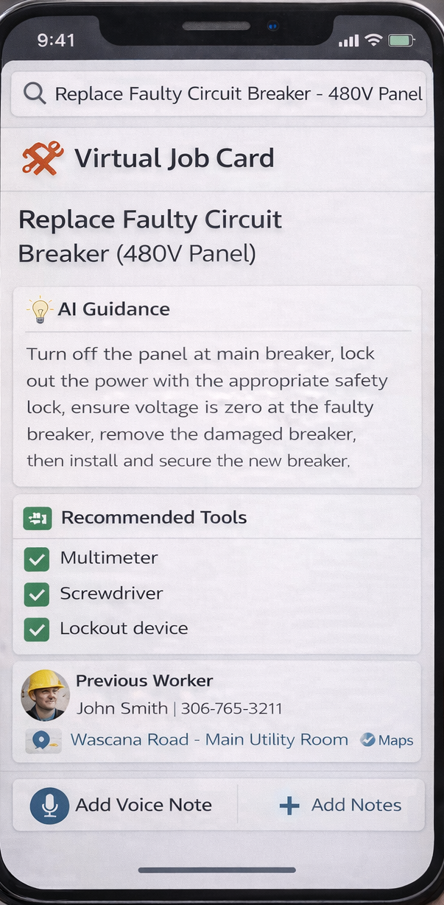
OUR PRODUCT - JOB CARDS
AUDIO CAPTURE
POST PROCESSING
LLM PROCESSING
INTERFACE
USERS
DATABASE AGGREGATION

Slide 5
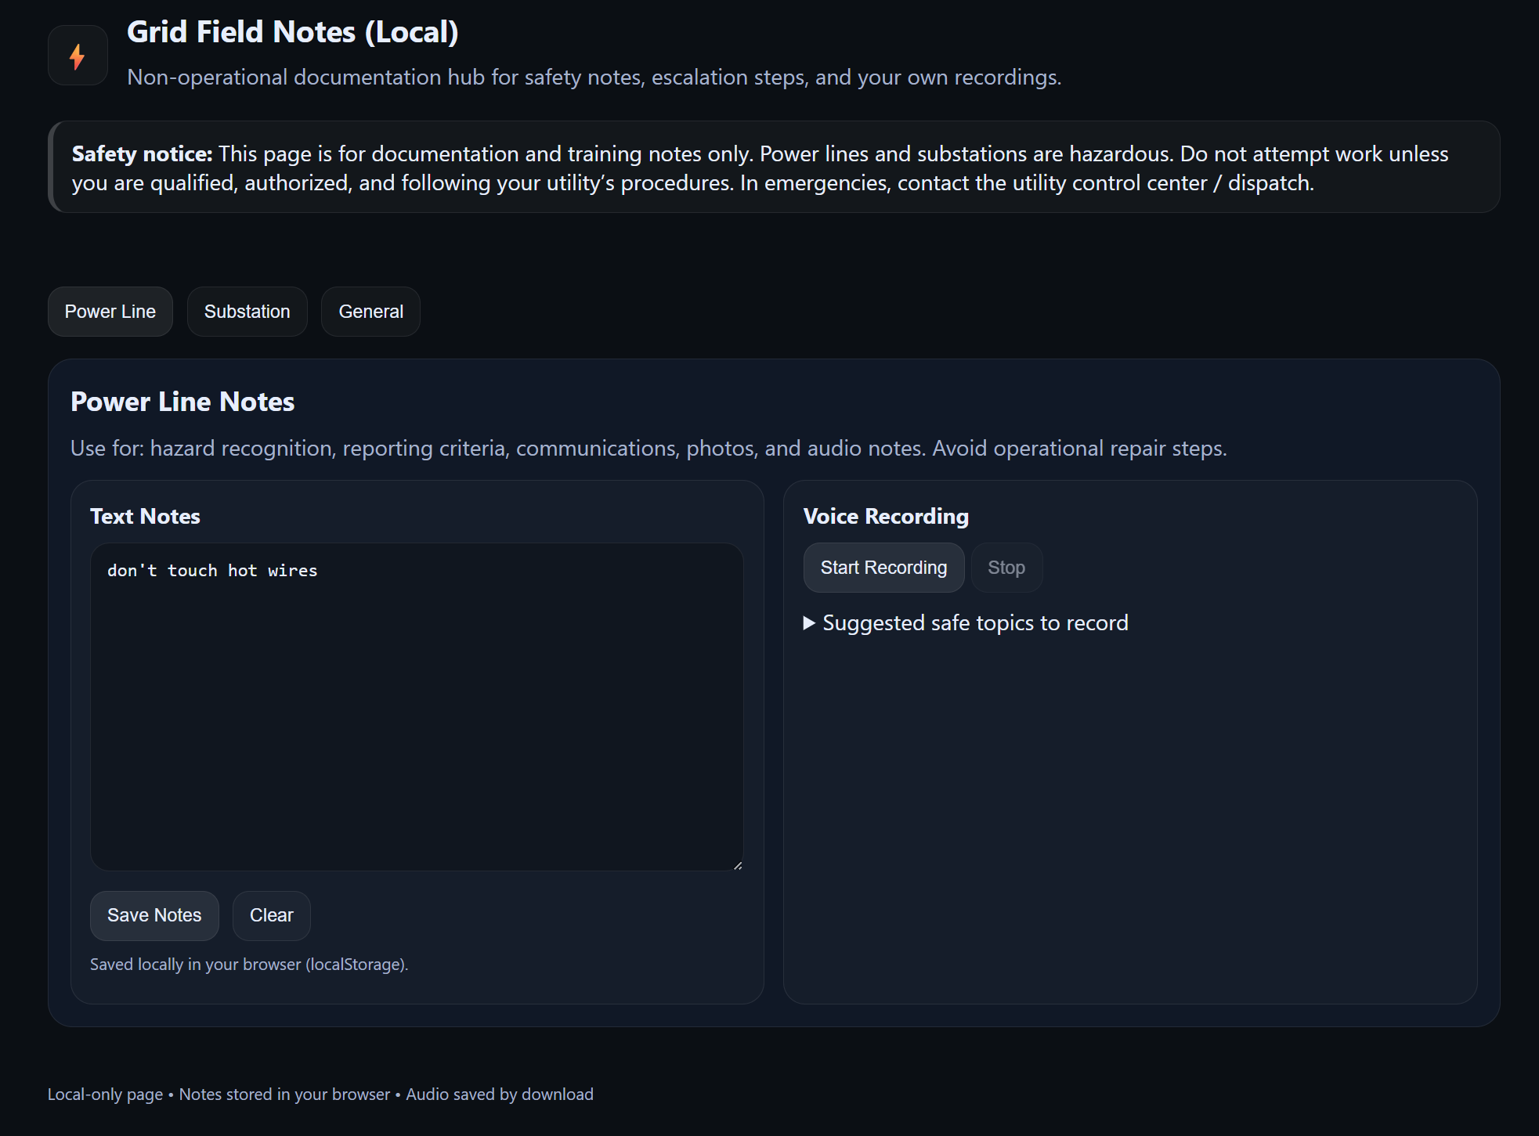
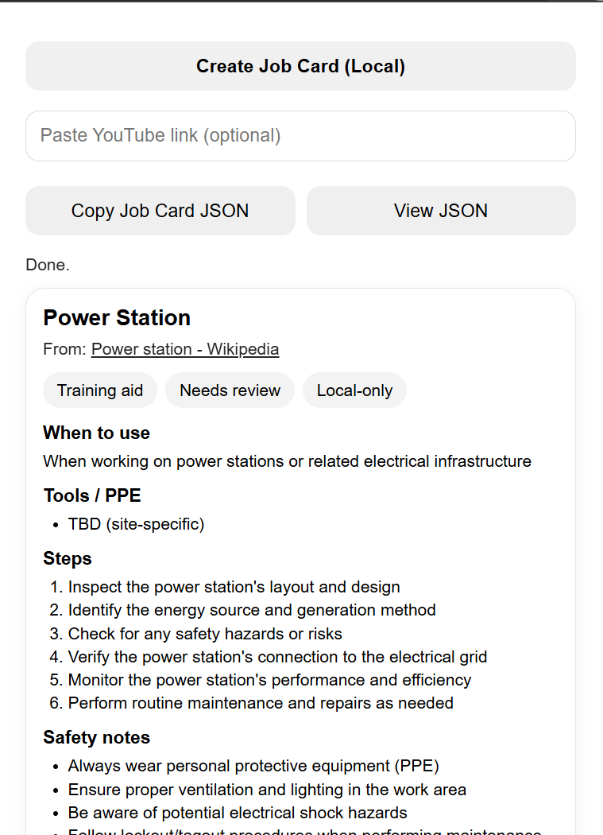
SOFTWARE PROTOTYPE

Slide 6
BUSINESS MODEL
PRICING
MARKET
Private Server (Set-Up Cost) - $10,000
Annual Maintenance Fee - $2500/year
Annual Employee Fee - $100/year
- 6200 utilities sector employees
- 950+ are retirement age
- 650+ are under 30 years old
BARRIERS
DIFFERENTIATOR
- Reluctance to adopt new technologies
- Privacy concerns
- Liability issues
- Removes manuals and logbooks
- Hands-free, voice-first approach
- No formal training/faster on-boarding
INCENTIVES
NEXT STEPS
-Work with companies to track data
- Paid time allocation
- Free lunches
- Run pilot program with SaskPower
- Focus on 5-10 common tasks for training
- Integrate with other Crown’s (SaskTel, SaskEnergy, SGI, SaskHealth, etc. )

